Slide 1
MRI Course HW2
四電機四甲 B10907034 王信舜

Slide 2
Raw Images

Slide 3
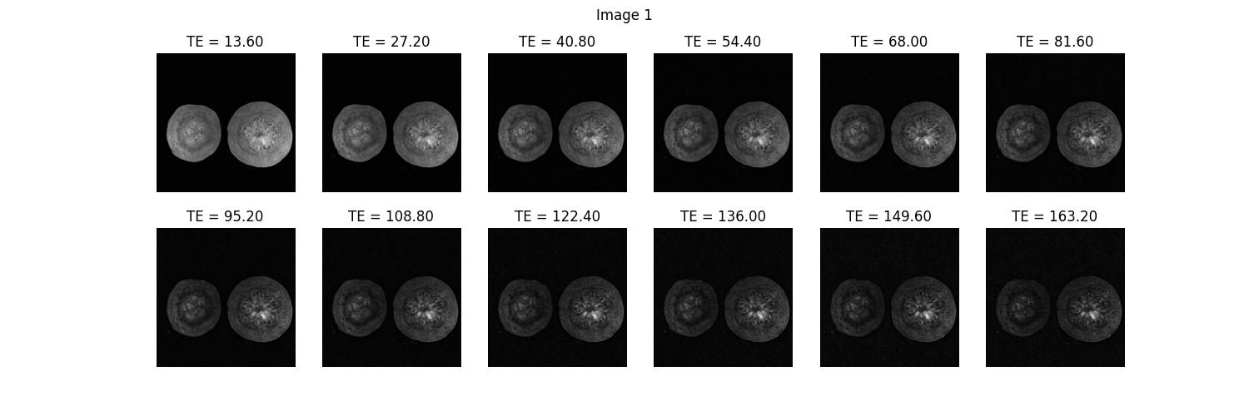

Slide 4
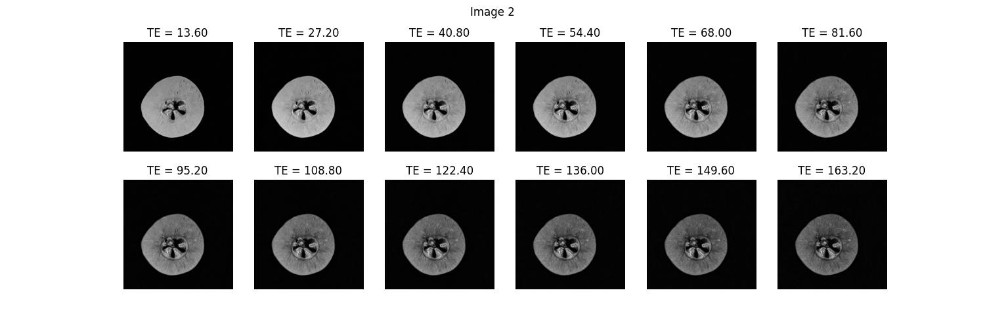

Slide 5

scipy.stats.linregress()
$$\log_{e}{Mxy= \log_{e}{{(M}_{0})+(\frac{−1}{T2})}}TE$$
$$Y=β+αx$$
$$M_{0}=e^{β}$$
$$T2=\frac{−1}{α} if \left|α\right|> \frac{1}{160} else 0$$

Slide 6
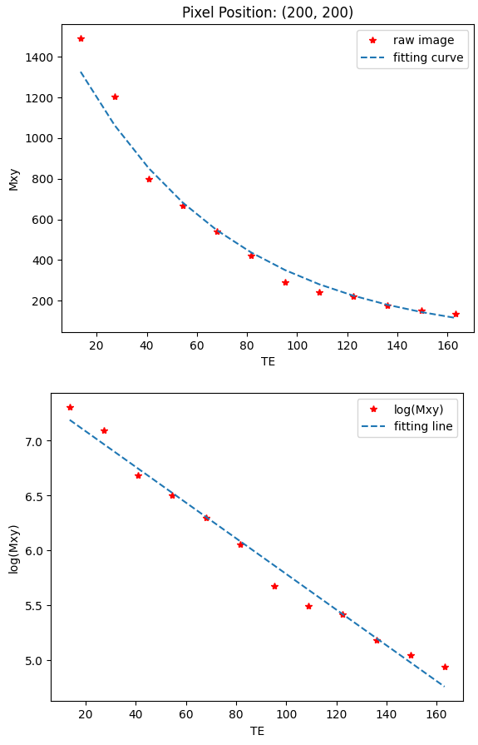
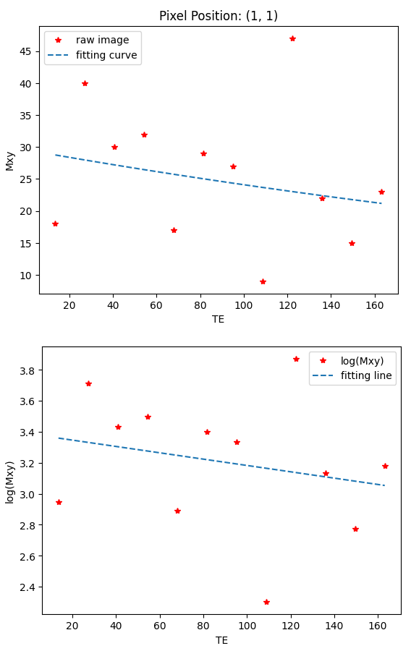

Slide 7
Preprocessing
目標: 去除背景雜訊

Slide 8
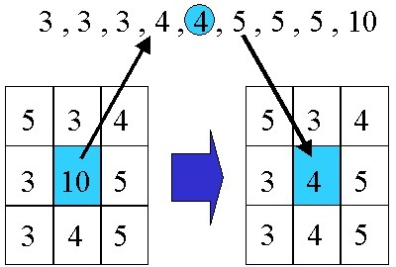
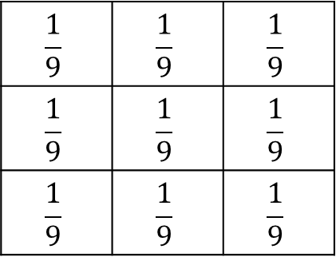
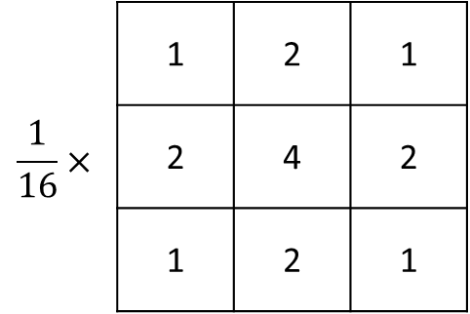
各種Blur
Median Blur
Gaussian Blur
Average Blur
$$\frac{1}{9}$$ | $$\frac{1}{9}$$ | $$\frac{1}{9}$$
$$\frac{1}{9}$$ | $$\frac{1}{9}$$ | $$\frac{1}{9}$$
$$\frac{1}{9}$$ | $$\frac{1}{9}$$ | $$\frac{1}{9}$$
 | 1 | 2 | 1
$$\frac{1}{16}×$$ | 2 | 4 | 2
 | 1 | 2 | 1

Slide 9
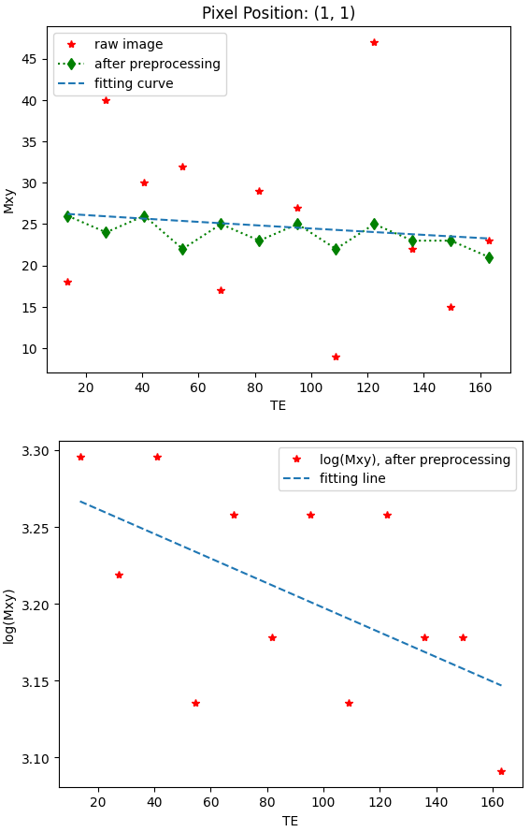
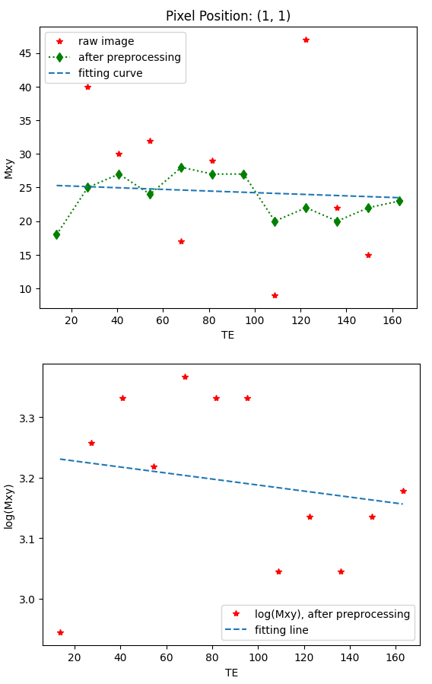
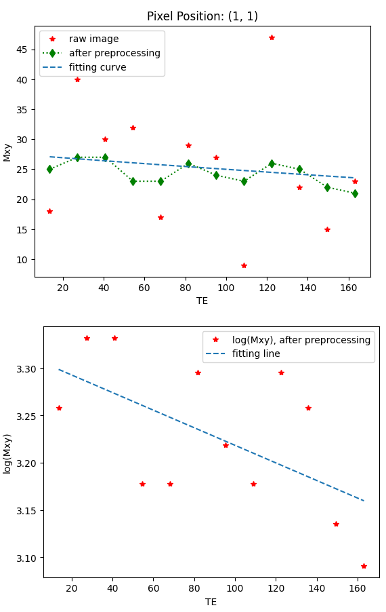
Average Blur
Median Blur
Gaussian Blur

Slide 10
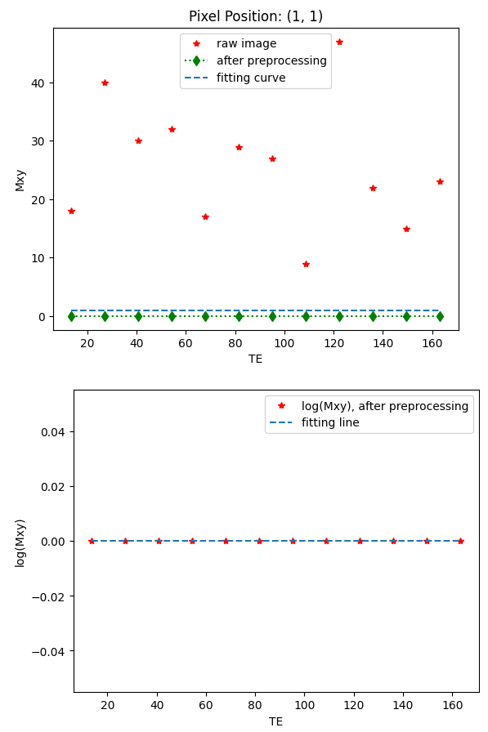
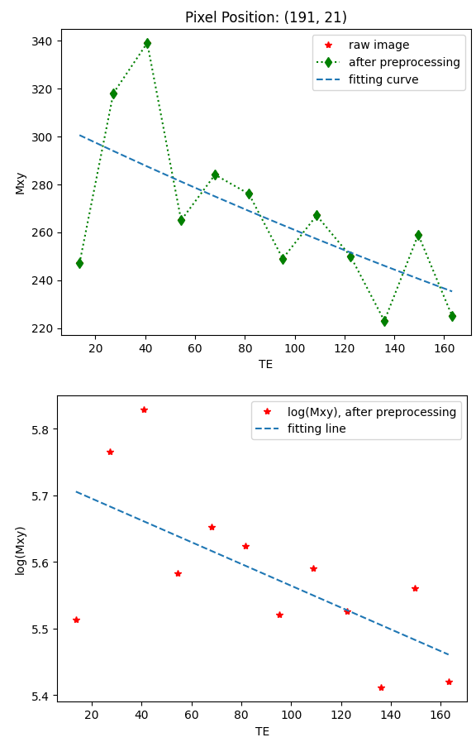
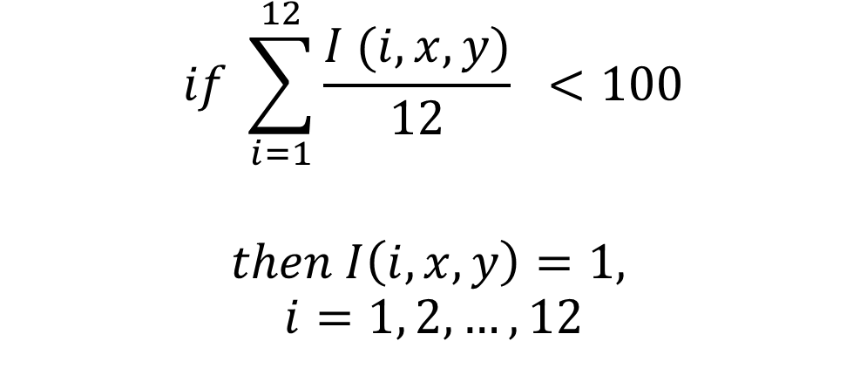
Mean小於一定值, 該pixel value=1
$$if \sum_{i=1}^{12}{\frac{I (i, x,y)}{12}} <100$$
$$then I\left(i, x, y\right)=1,$$
$$i=1, 2,…,12$$

Slide 11
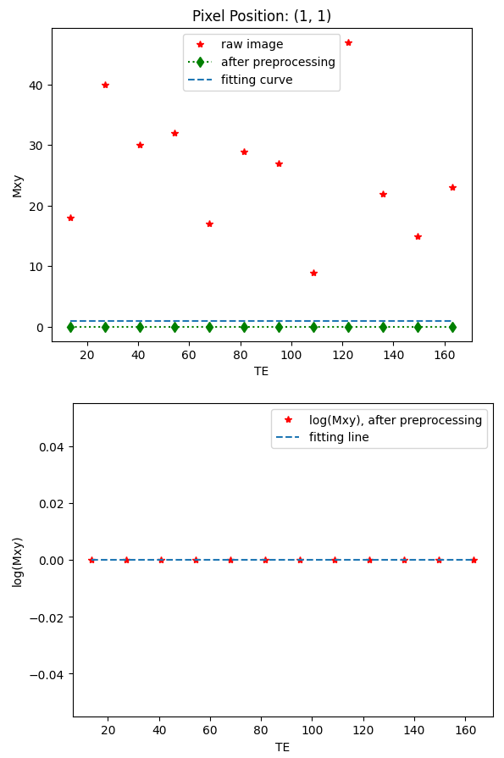
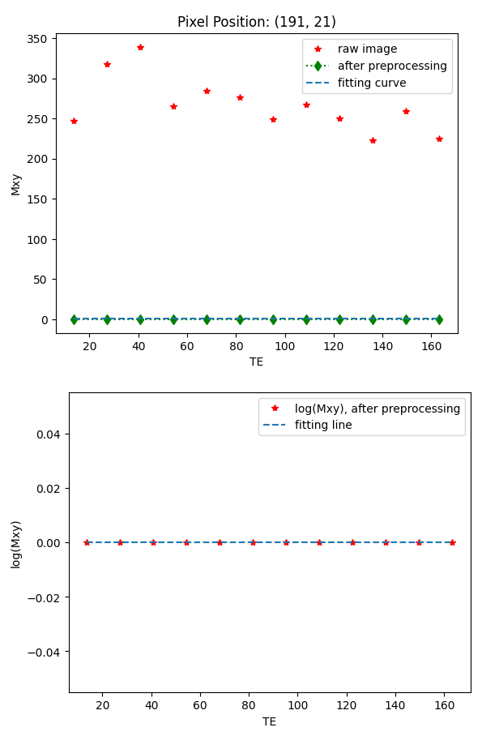
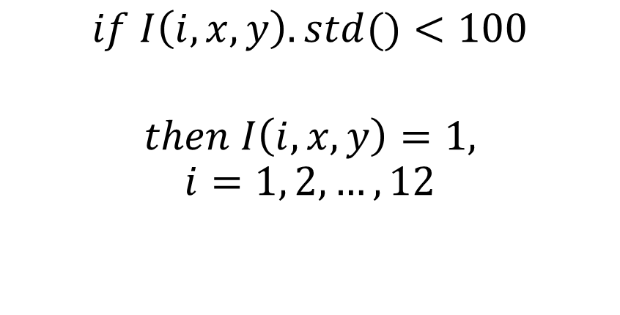
Std小於一定值, 該pixel value=1
$$if I\left(i, x,y\right).std()<100$$
$$then I\left(i, x, y\right)=1,$$
$$i=1, 2,…,12$$

Slide 12
Average RMSE (only count when T2 > 0)
Fitting method |  | linregress
Preprocessing Method |  | Average Blur | Median Blur | Gaussian Blur | Std theshold | Mean theshold
Image | 兩顆 | 70.037 | 64.917 | 64.297 | 52.251 | 52.171
 | 一顆 | 83.547 | 73.037 | 74.681 | 59.707 | 59.567

Slide 13
T2 Map

Slide 14
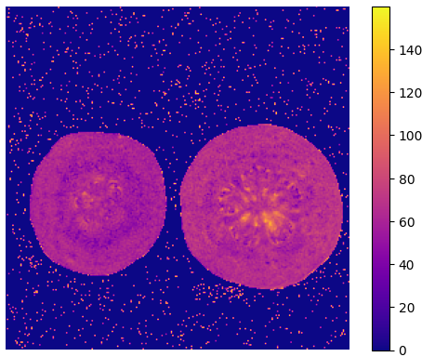
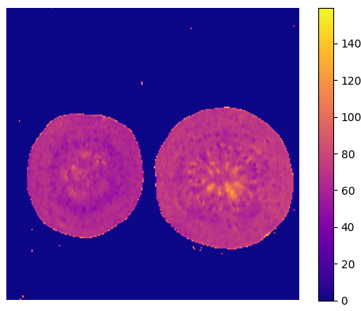
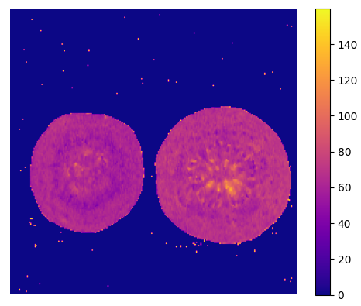
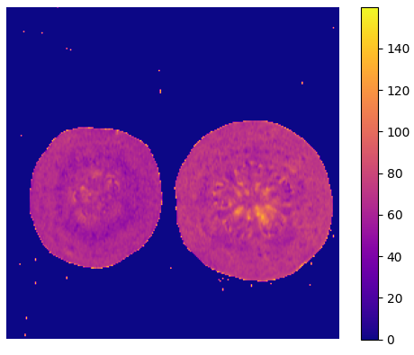
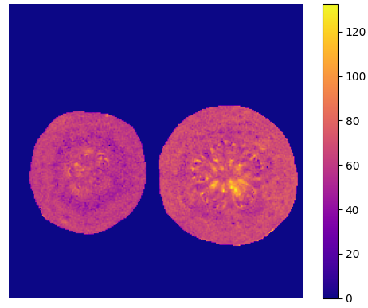
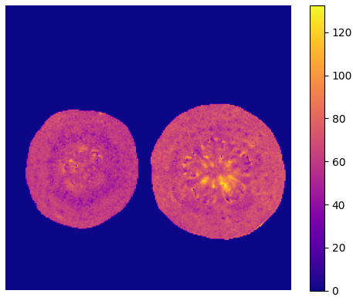
Raw
Average Blur
Median Blur
Gaussian Blur
Mean Threshold
Std Threshold

Slide 15
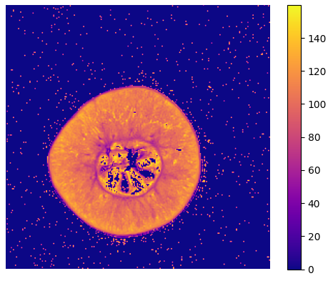
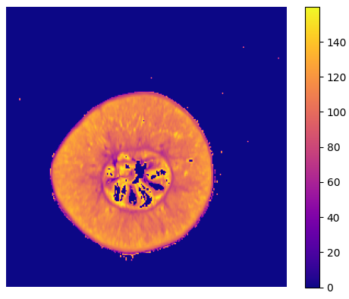
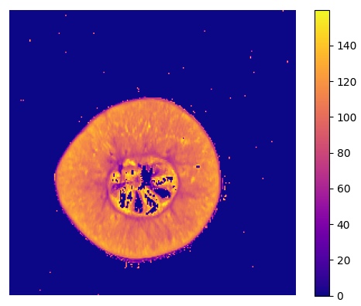
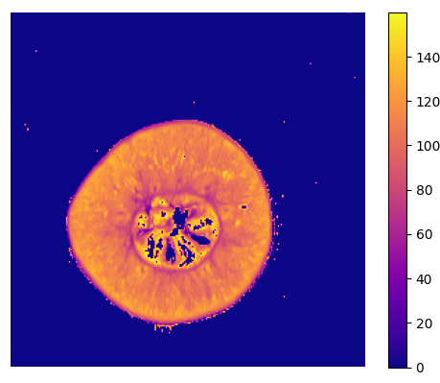

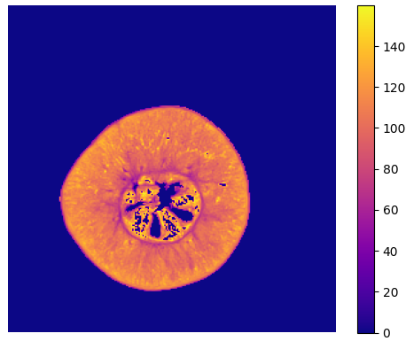
Raw
Average Blur
Median Blur
Gaussian Blur
Mean Threshold
Std Threshold

